Slide 1



Dynamic Modeling of Mosquito Vectors of Malaria
Sonia Sen
Mentor: Dr. Andrew Comrie
Arizona/NASA Space Grant Undergraduate Research Internship Statewide Symposium
April 21, 2012

Slide 2
Climate Change and Health: Malaria
247 million people worldwide are affected by malaria
  1 million deaths annually
  1.6 million infected in the Indian subcontinent
Climate change projections show tropical areas predict vector-borne diseases moving to higher latitudes and altitudes, covering 10% more area in 2080 than 2000
Notes:
-malaria predominant in tropical and subtropical regions, including much of Sub-Saharan Africa, Asia, and the Americas.
-Amarasinghe et al. India’s water supply and demand from 2025-2050: Business as Usual Scenario and Issues. IWMI
India National Communications. 2004
Changes in vector habits and habitats could affect malaria transmission
Climate (e.g., temperature, precipitation)
Impact of climate variables on vector life-cycle
Malaria prevalence (i.e., disease data)

Slide 3
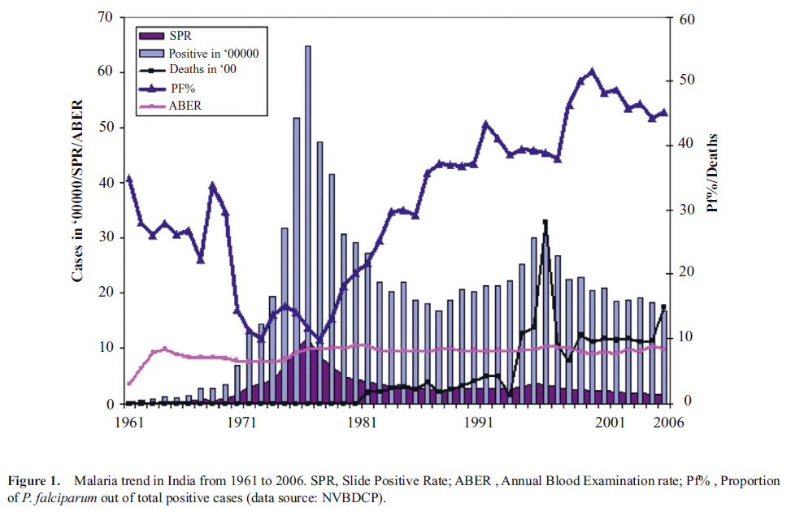

Slide 4
Modeling and Malaria
Goals:
  Develop a climate-driven model of Anopheles vector
  Validate model on observed mosquito abundance in selected geographic locations
  Assess impact of climate change on mosquito abundance and implications for risk of disease
Project Focus
  Literature search: climate effects on parasite and vector, other models
  Changing parameters:
    Daily temperature, precipitation
    Lifecycle stages (vector and parasite)
Notes:
Cc; malaria complex disease affected by social and environmental factors (i.e. climate change)
Worst case: 1.4 degrees increase in global mean temp; important to understand climate variables impact these diseases
Heres our climate data and how we are using this; climate, vector, disease data needed
1)modle impact of cc on anopheles vector 2) long term goal: incorporate parasite (disease agent) into model

Slide 5
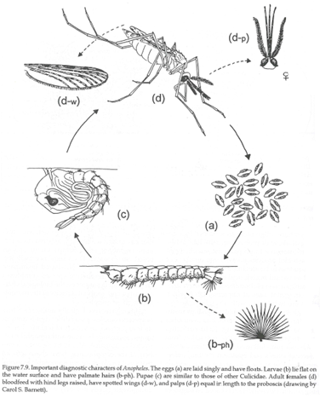
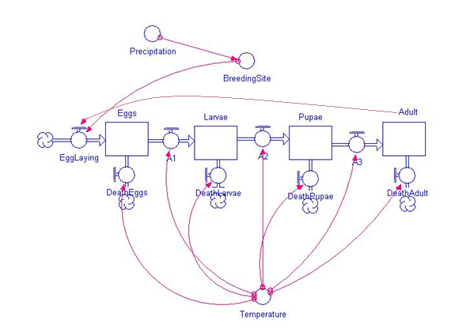
Dynamic Mosquito Simulation Model
DyMSiM, 2010
Notes:
The Dynamic Mosquito Simulation Model (DyMSiM) enables the simulation of mosquito populations driven by climate data. DyMSiM provides a useful tool for researchers investigating a number of mosquito-borne diseases. Because the model is driven by local temperature and precipitation inputs, and requires the specification of additional habitat and land-cover parameters, the model is designed to generate mosquito population counts based on environmental conditions at a location as defined by the user. This website provides information about the model, download details for the model code, how to enter data and run the model, and additional background on how this tool can be tailored to address varying research questions.
Vector habitat (water available) determines the resources available for egg laying and larval development. It enters the system through precipitation, irrigation, and as a function of specified land cover. Water exits the system via soil infiltration and evaporation. Temperature impacts the evaporation rate of water, as well as governing the development of the mosquito throughout its life cycle.

Slide 6
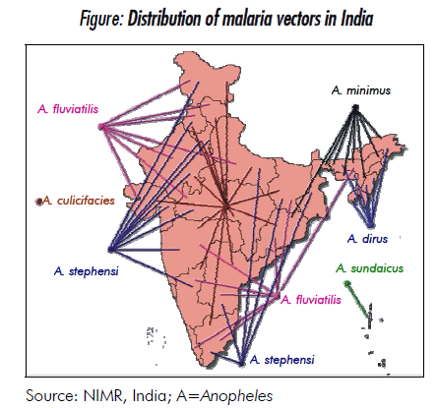
Malaria Disease Ecology
Protozoan parasite Plasmodium
  Plasmodium falciparum
Transmitted by female Anopheles mosquitoes (disease vectors)
Variable | Anopheles stephensi | Anopheles culicifacies
Environment | Urban | Rural
Temperature (ºC) | 28-40 | 35-45
Ecological preference | Endophilic | Endophilic
Humidity (%) | 50-60 | 50-70
Notes:
-water drainage, sewer systems
-water availability
-temp, precip, humidity
-elevation
Anthropophilic
Temperature, precipitation, humidity

Slide 7
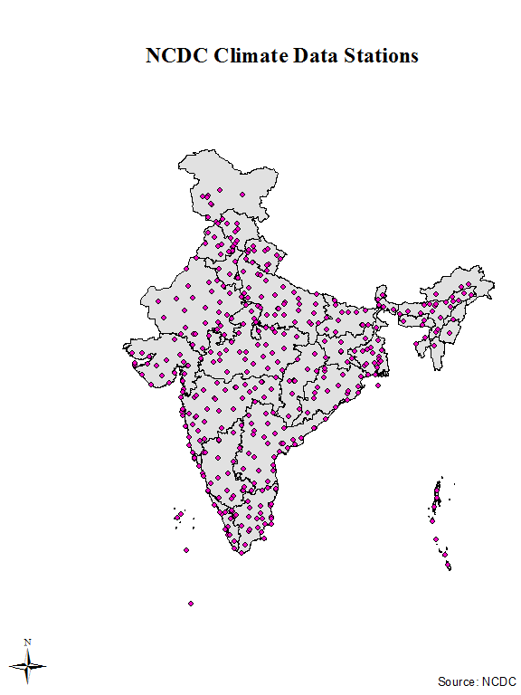
Station Data
Anopheles is ectothermic
  Affected by environment
  Temperature, precipitation, humidity
Station Data (593 Stations)
Mean temperature Mean dew point Mean sea level pressure Mean station pressure Maximum temperature Minimum temperature Precipitation amount
Average # of years of Data: 37 years

Slide 8
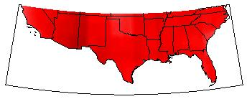
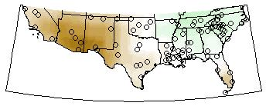
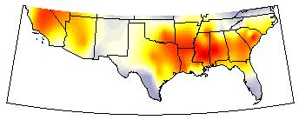

Next Steps…
Change in Temp C
Continuing development
  Testing with data
  Expanding software use
APRIL
Change in Prec %
THANK YOU
  Dr. Andrew Comrie
  Mona Arora
  Cory Morin
  ACES Lab
  AZ NASA Space Grant
Change in Mos Days
Notes:
Slide w climate station data; map w anticipated cc in india
Collect vector data, develop model, validate model, run projections **validation**
-needs to make model accurate; locations, areas, species can be projected eventually
Limitations of modeling: idealized view of reality; assumption on many factors; nature of problem complex wo data, this is best way to asses impact and do predictive modeling
THANKS
Dr. Andrew Comrie
Mona Arora
Cory Morin
ACES Lab
AZ NASA Space Grant

